Slide 1

Google Flight Findings
Frances
1/17/20

Slide 2
Agenda
Introduction
Process
Findings
Summary

Slide 3
Introduction
Purpose:
Crawl 60 days (onwards from current day) of pricing information from Google Flights daily
TPE-NRT, TSA-HND, one way, direct flight
Duration: 11/27/19 to 1/17/20
Tools: Python, Selenium, Hadoop, Tableau
Features:
Carrier code, flight number, flight date, departure time, departure airport, arrival airport, capture date, price, class

Slide 4






Process
+
Python
Selenium
Impala

Slide 5
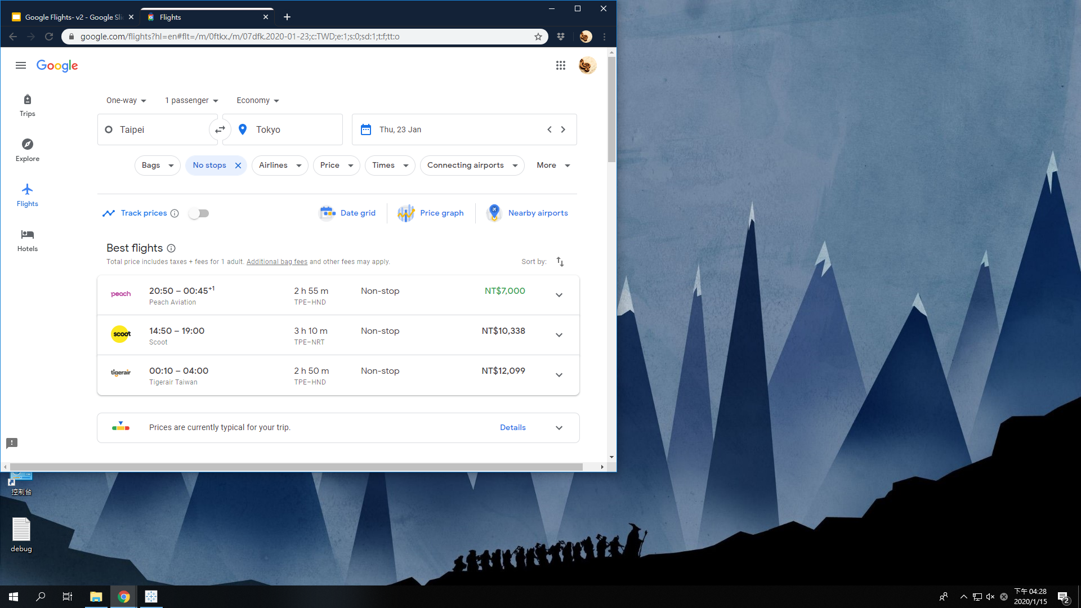
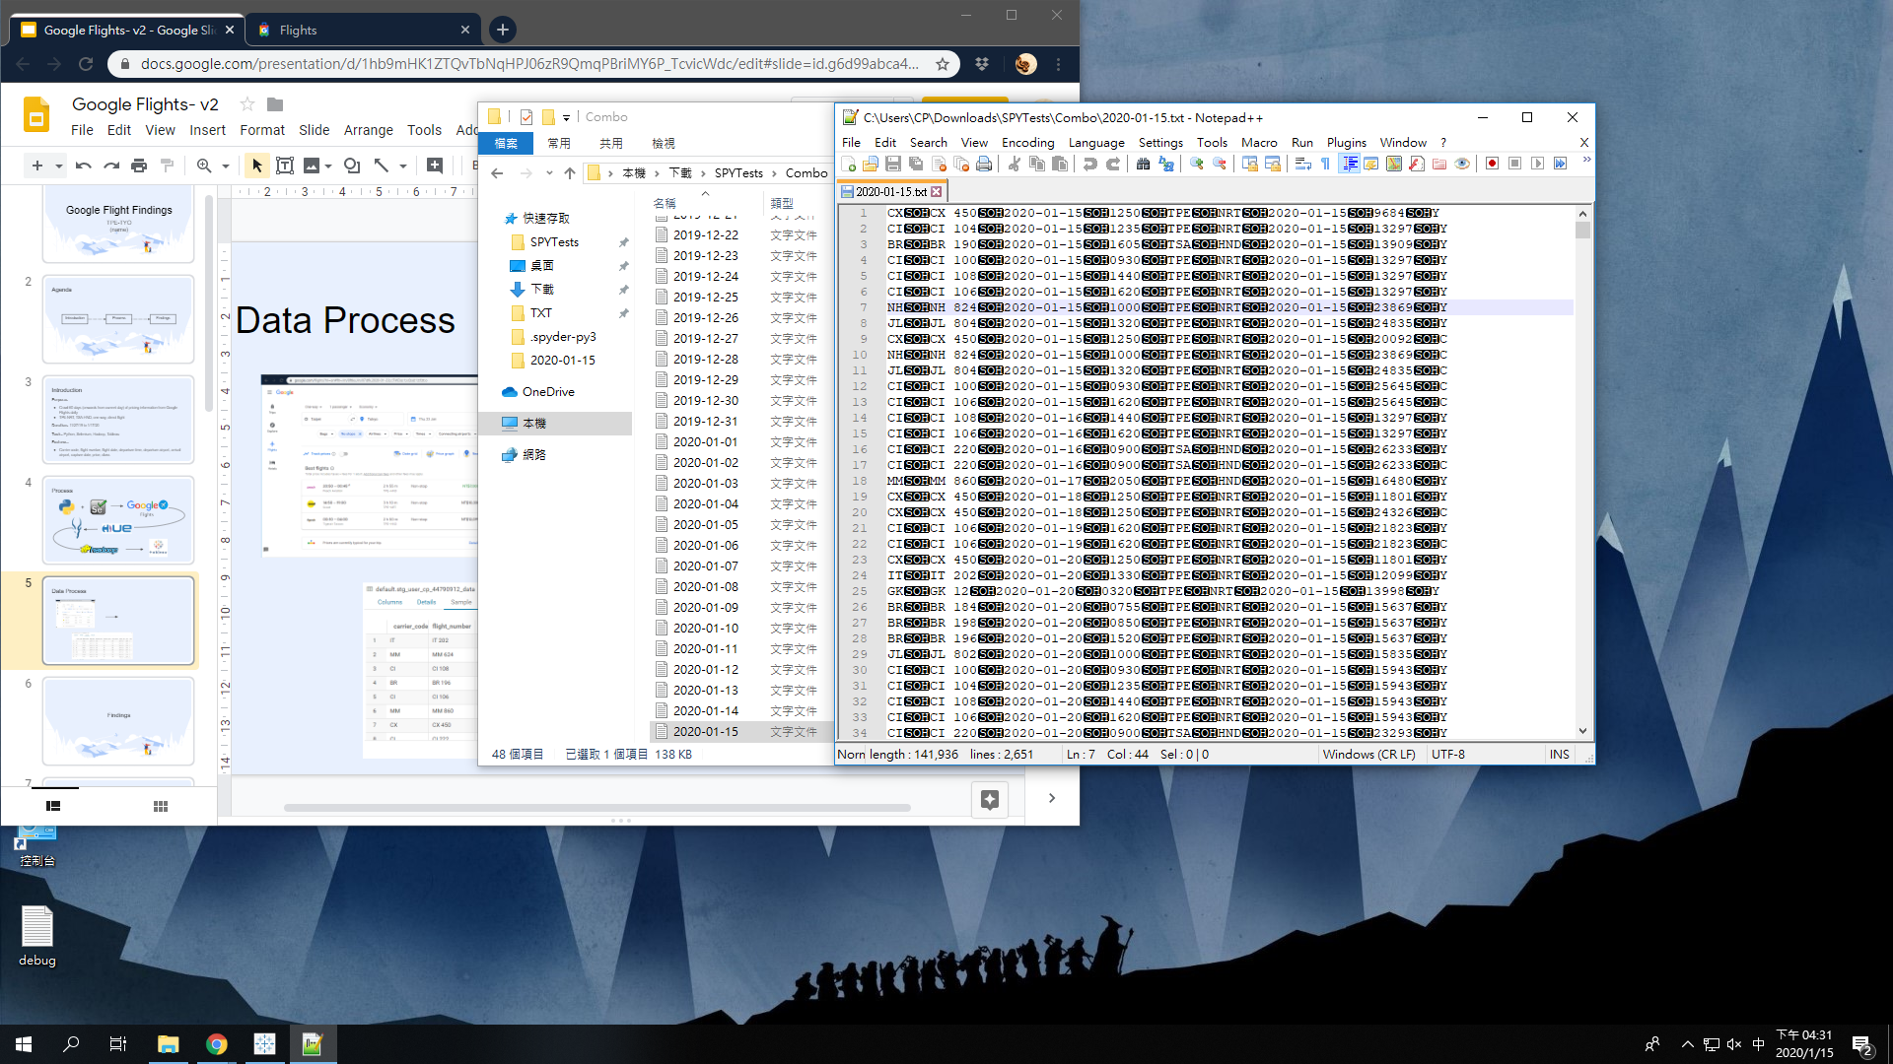
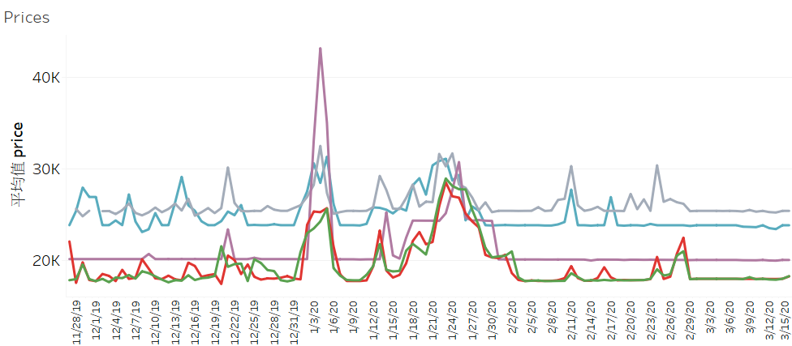
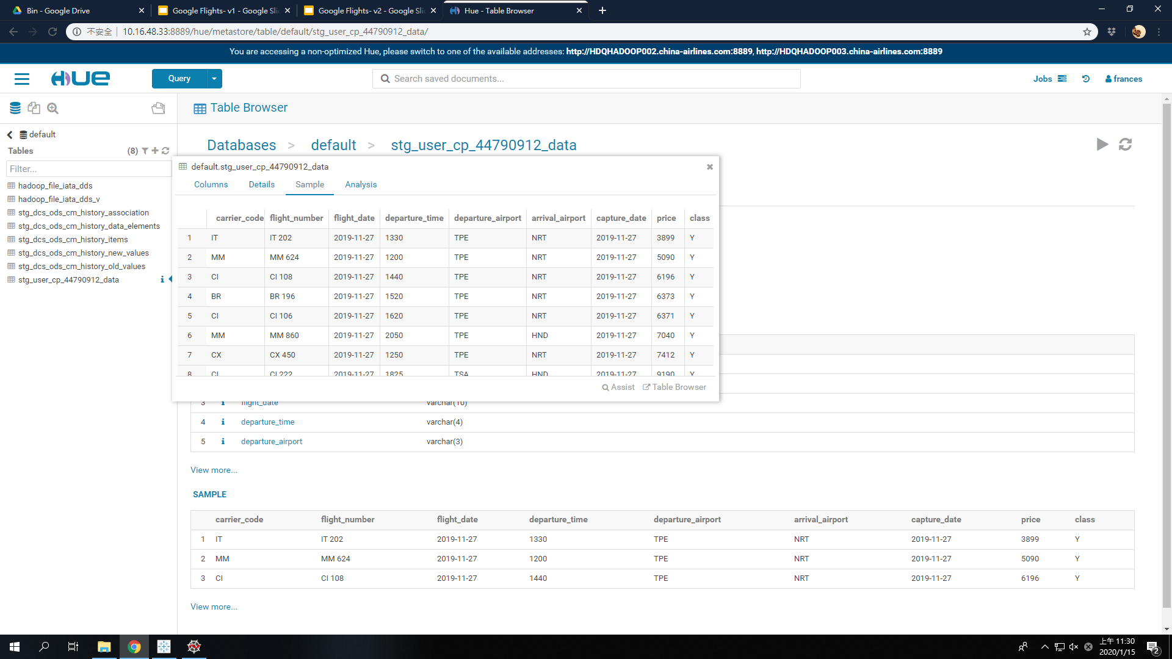
Data Process
Tab-separated file
Hadoop table
Tableau

Slide 6
Findings

Slide 7
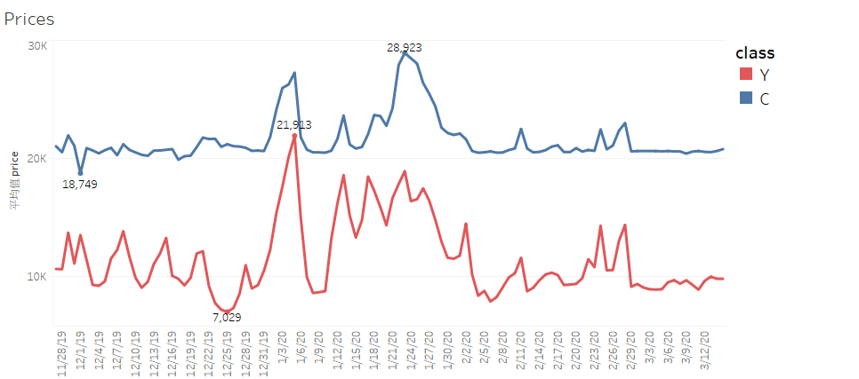
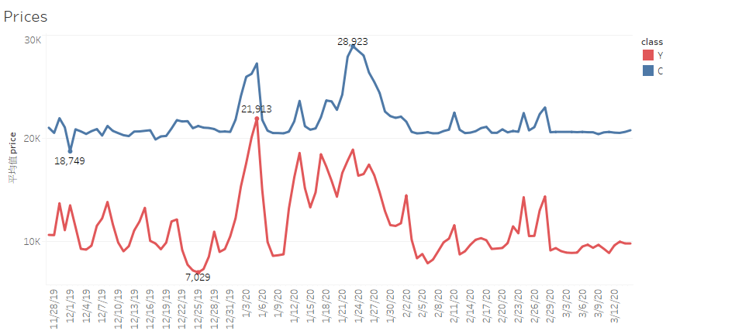
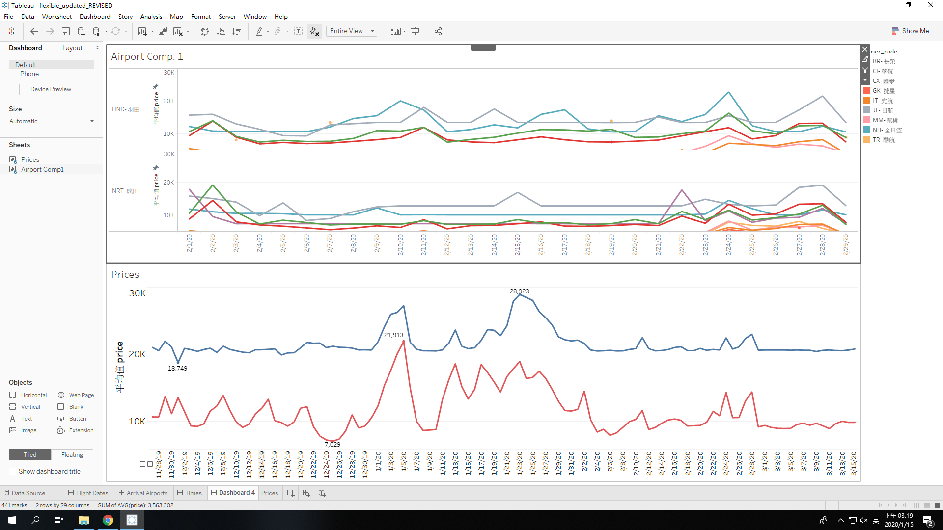
Pricing Classes
Business peaks around Chinese New Year (1/23)
Economy is most expensive during 1/03- 1/05: likely due to people returning home to Japan after the New Year holiday
Prices
30K
20K
10K

Slide 8
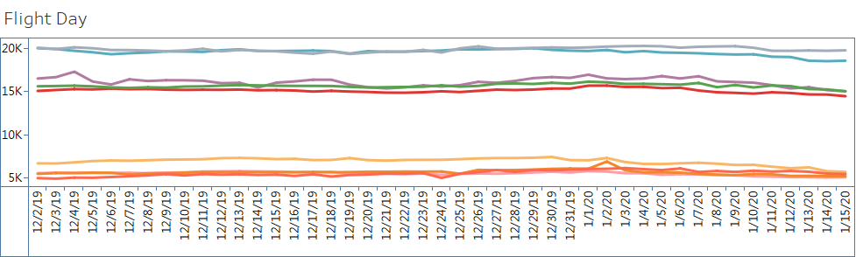
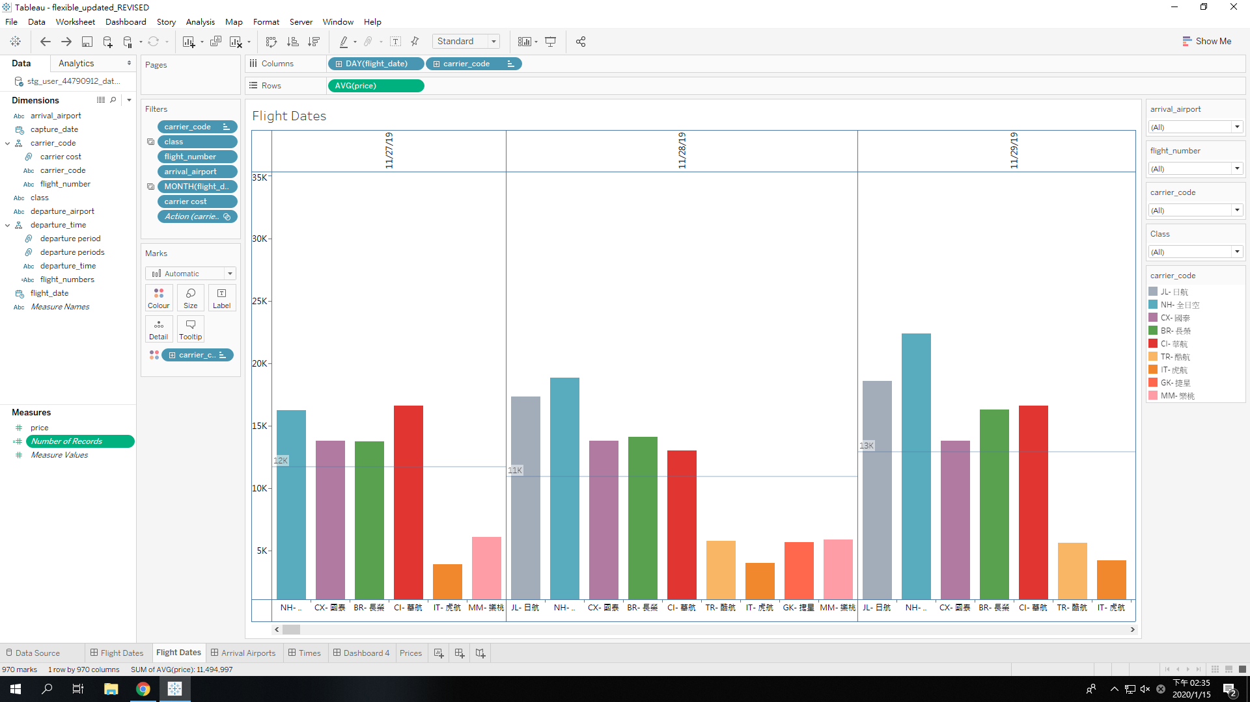
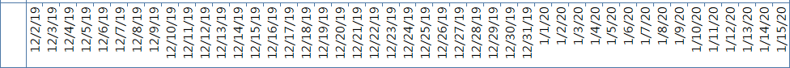
Capture Dates
Based on average prices captured per day, carriers can be split into three groups: low-cost, medium and expensive
Capture Day
carrier_code
JL 日航
NH 全日空
CX 國泰
BR 長榮
CI 華航
TR 酷航
IT 虎航
GK 捷星
MM 樂桃

Slide 9
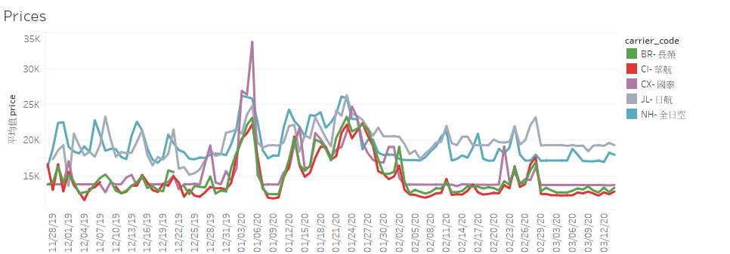
Flight Dates- Carriers
CI tends to be the cheapest carrier as a whole and is well below the average for the vast majority of departure days
CI generally follows the same pattern as BR
Prices
35K
carrier_code
JL 日航
NH 全日空
30K
CX 國泰
BR 長榮
CI 華航
25K
20K
15K

Slide 10
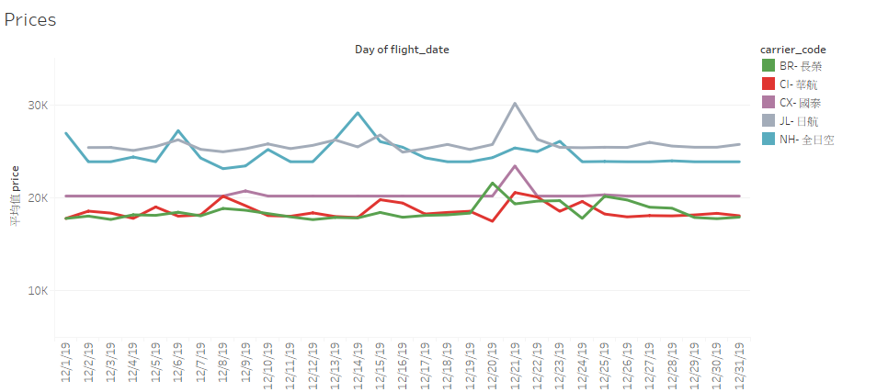
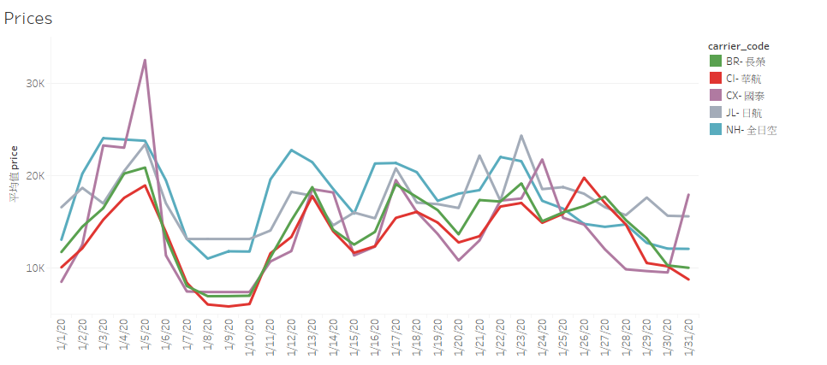
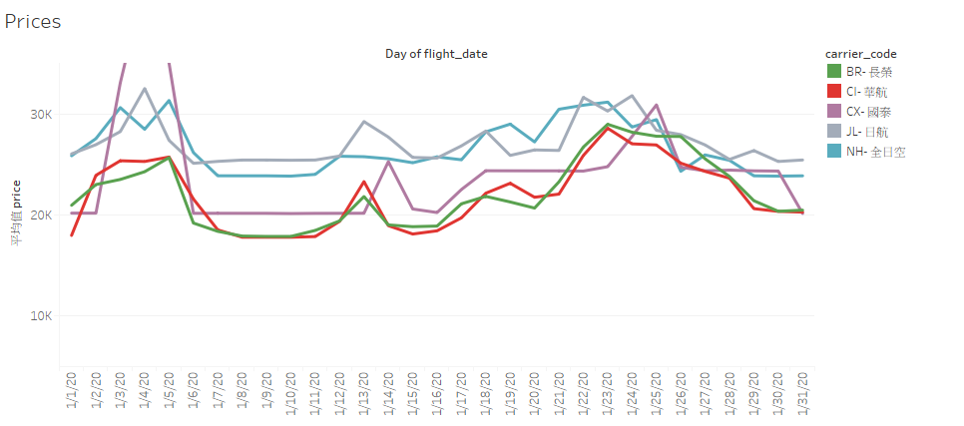
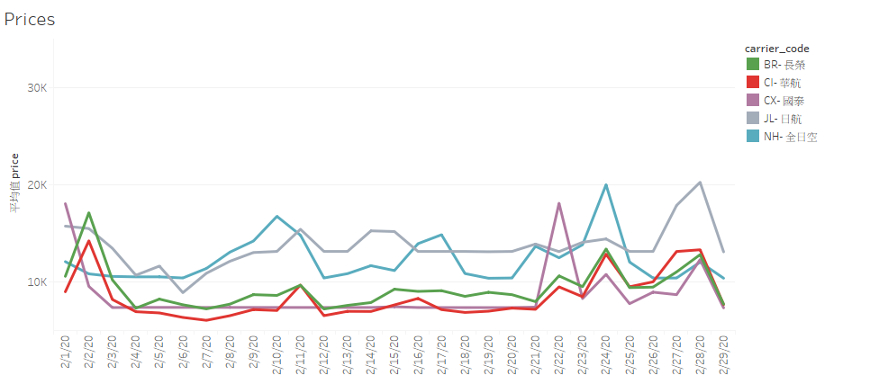
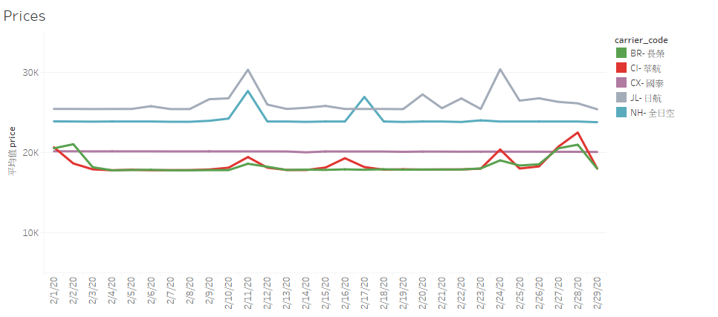
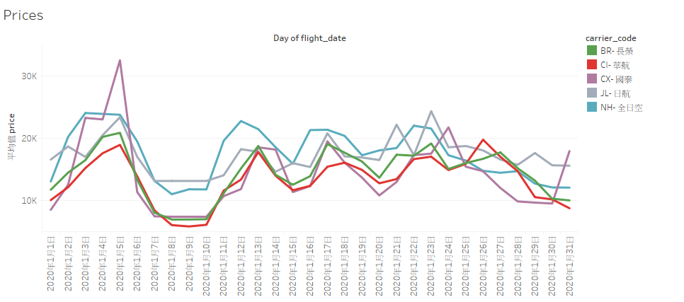
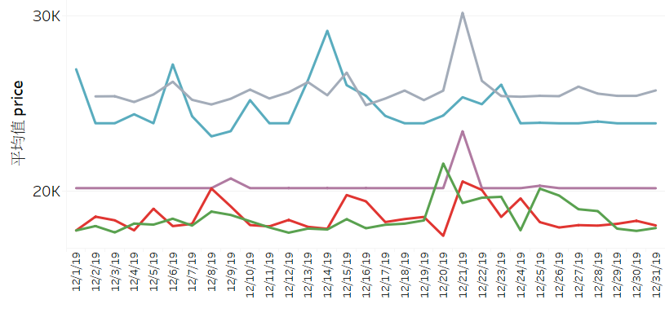
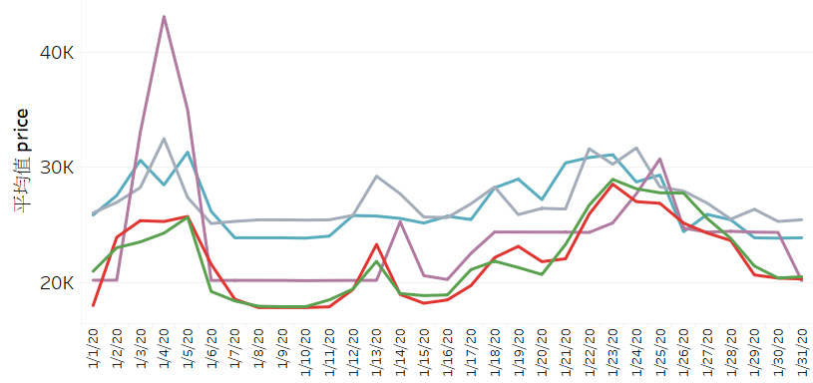
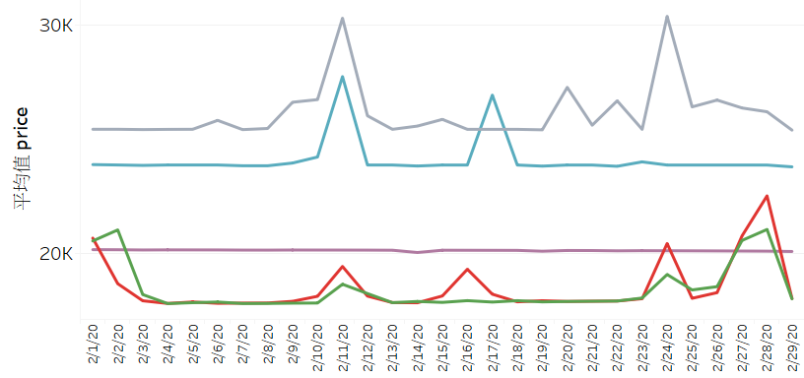
Flight Dates- Specifics
Prices
carrier_code
30K
JL 日航
NH 全日空
CX 國泰
BR 長榮
CI 華航
20K
10K
12/2019
1/2020
2/2020
C
Y
C
Y
C

Slide 11
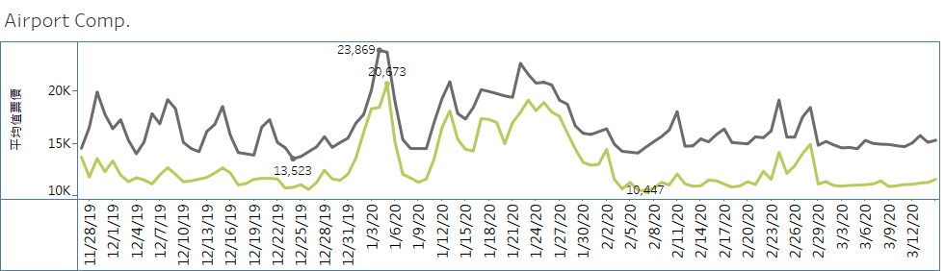

Arrival Airports
HND more expensive than NRT
HND and NRT pricing tend to follow the same patterns but HND peaks more sharply
arrival_airports
HND 羽田
NRT 成田

Slide 12
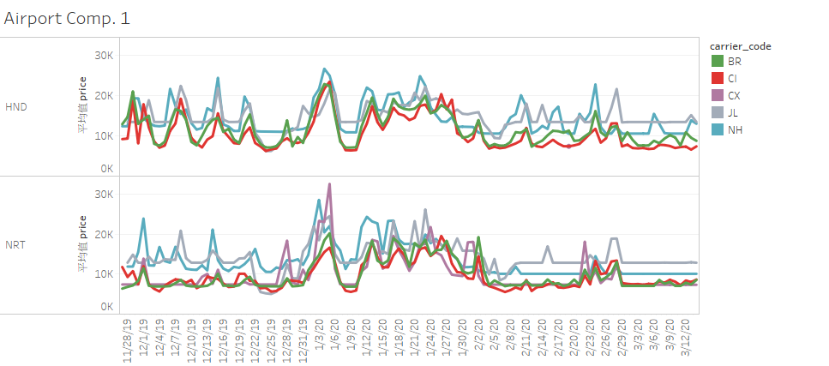
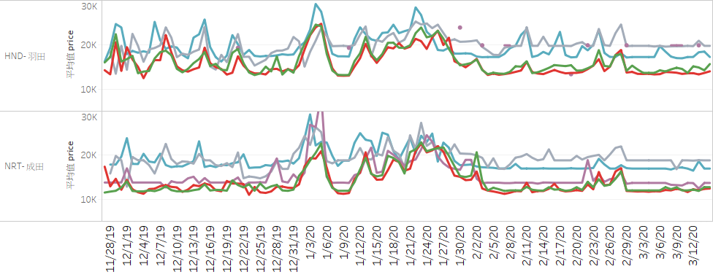
Arrival Airports- Carriers
CI is visibly the cheapest carrier for flights to HND
CI is slightly more even with BR for flights to NRT, but still cheap
30K
carrier_code
JL 日航
NH 全日空
HND羽田
20K
10K
CX 國泰
BR 長榮
CI 華航
30K
NRT成田
20K
10K

Slide 13
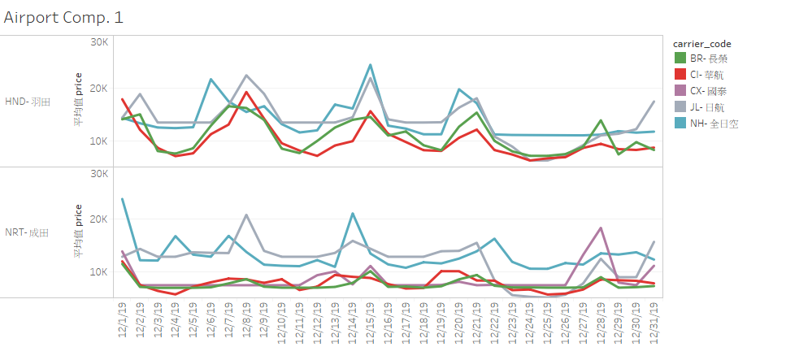
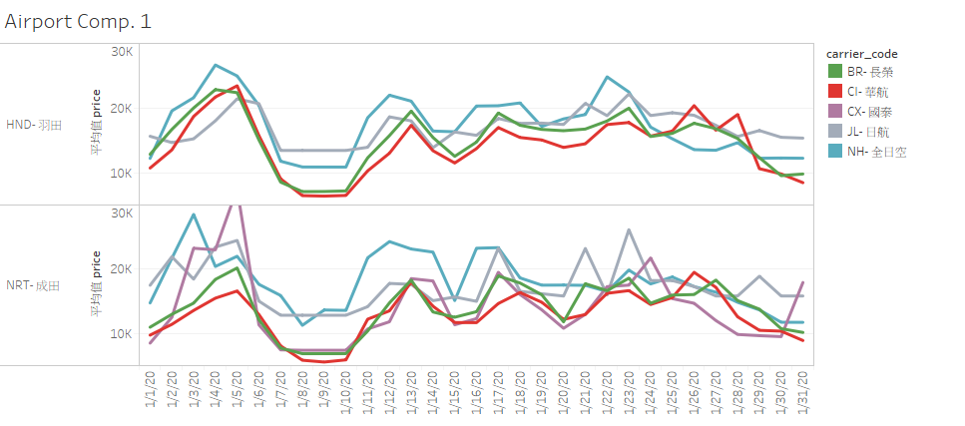
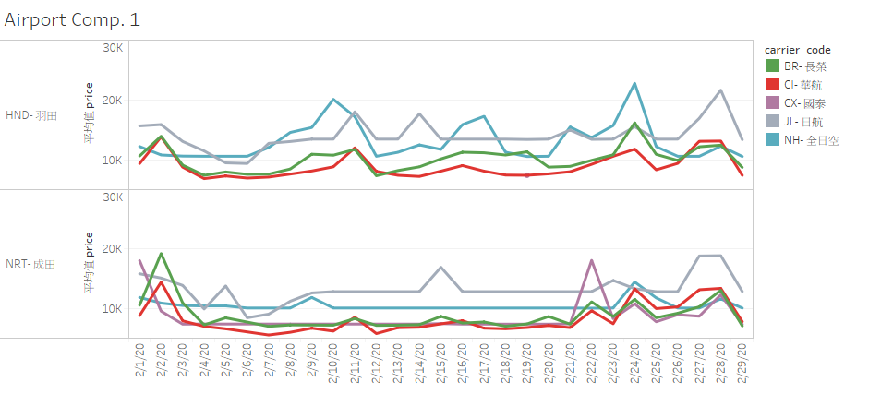
Airports- Specifics
carrier_code
JL 日航
NH 全日空
CX 國泰
BR 長榮
CI 華航
20K
HND羽田
10K
20K
NRT成田
10K
12/2019
1/2020
2/2020
Y
Y
Y

Slide 14
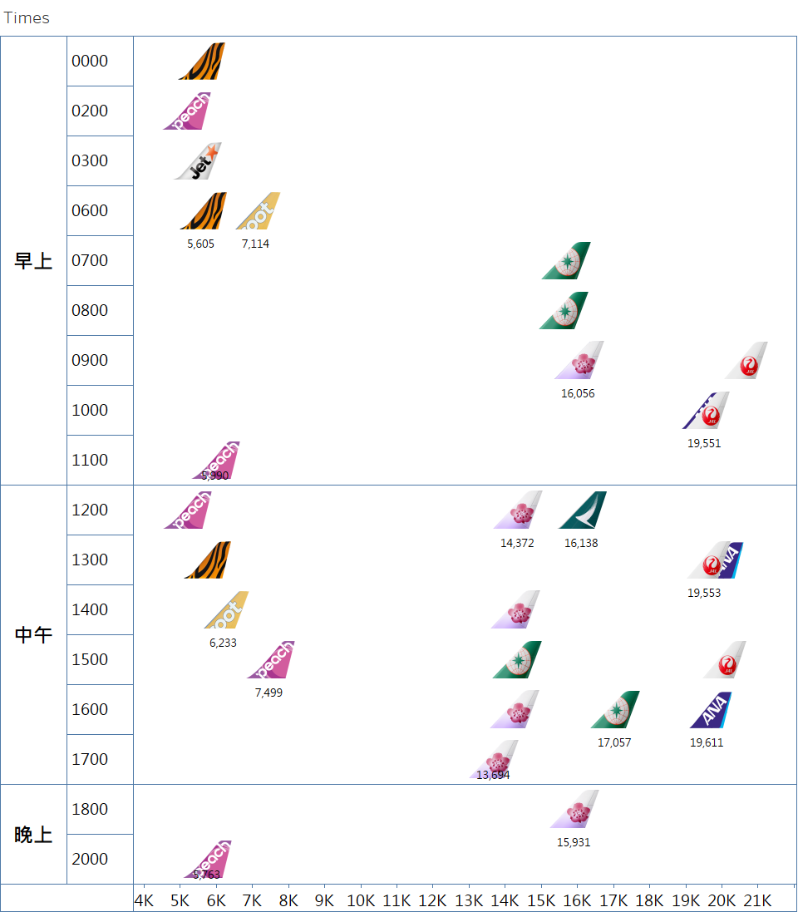
Times
Times
Clear gap between LCC and other carriers
Most expensive at midday
CI, BR and CX are the cheaper of non-LCC carriers
JL and NH are more expensive

Slide 15
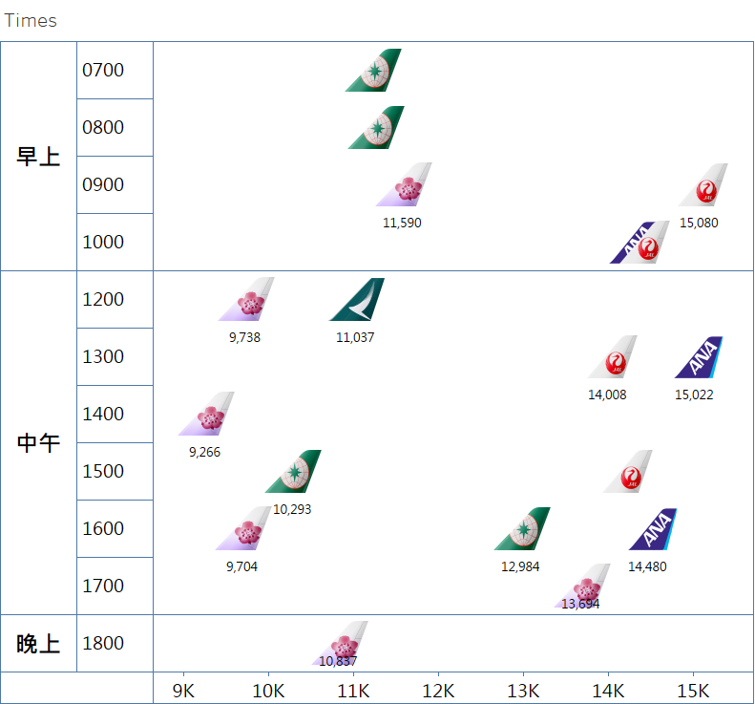
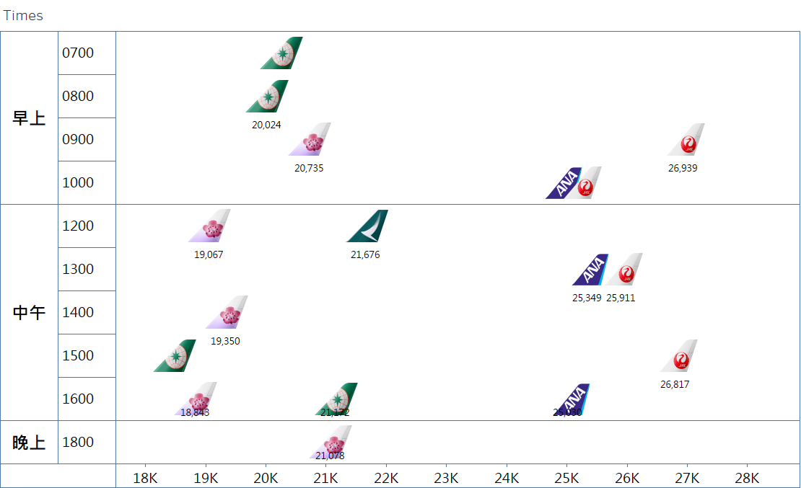
Times- C Cabin
Times- Y Cabin
Times
Times

Slide 16
Demo- Tableau
Flight Dates
Displays average carrier prices of flight dates separated by month and class, drill down on a specific day to see daily captures of flight prices for that day.
Arrival Airports
Contrasts flight date prices split by arrival airports (HND, NRT) , month and class. The lower graph shows average carrier prices for flights also split by arrival airports.
Time
Splits carrier pricing by departure times- mornings, afternoons and evenings, and by hourly periods.

Slide 17
Summary
CI tends to be the cheapest carrier (excluding LCC)
Generally follows BR pricing patterns
HND economy pricing could be increased- almost always cheaper than other carriers
CI prices could generally be increased, currently at lower end of price range among carriers based on time graph

Slide 18
Recommendations
To improve running time, can try using headless browsers with Selenium
No browser GUI = no need to render HTML → lower memory, CPU
Potentially 2x faster performance
chrome_options.add_argument("--headless")
Could potentially cut out middle step of using Impala and Hadoop since Tableau can also read csv and text files
Impala doesn’t support split() or date(), had to use datetime() in Tableau instead

